Slide 1
Opertaing system
Purnima maam,
Unit 1

Slide 2
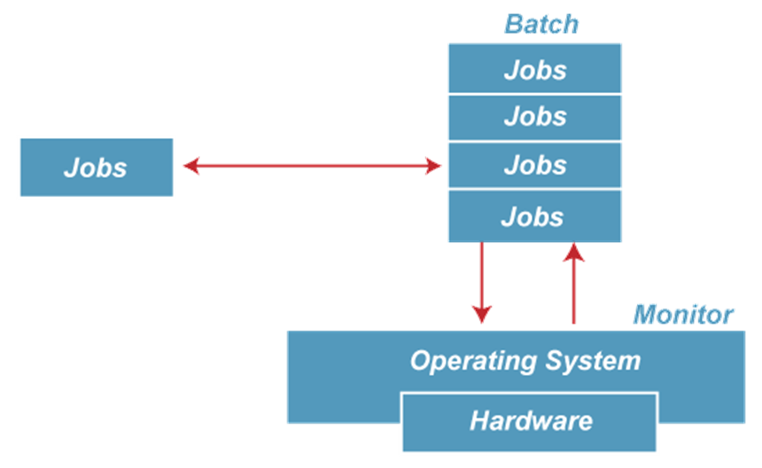
***Types of Operating System***
In the 1970s, Batch processing was very popular. In this technique, similar types of jobs were batched together and executed in time. People were used to having a single computer which was called a mainframe.
In Batch operating system, access is given to more than one person; they submit their respective jobs to the system for the execution.
The system put all of the jobs in a queue on the basis of first come first serve and then executes the jobs one by one. The users collect their respective output when all the jobs get executed

Slide 3
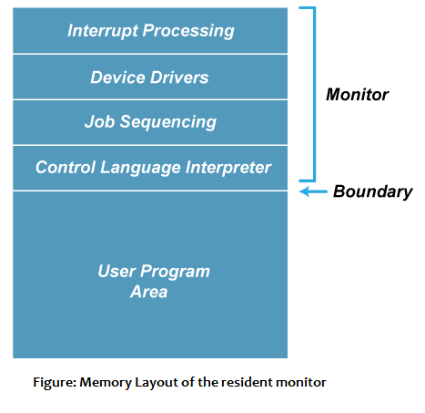
The users of a batch operating system do not interact with the computer directly. Each user prepares his job on an off-line device like punch cards and submits it to the computer operator. To speed up processing, jobs with similar needs are batched together and run as a group.
PURPOSE:-
The purpose of this operating system was mainly to transfer control from one job to another as soon as the job was completed. It contained a small set of programs called the resident monitor that always resided in one part of the main memory. The remaining part is used for servicing jobs

Slide 4
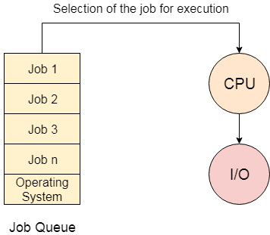
Advantages of Batch OS
The use of a resident monitor improves computer efficiency as it eliminates CPU time between two jobs.
Disadvantages of Batch OS
Starvation
Batch processing suffers from starvation.
For Example
There are five jobs J1, J2, J3, J4, and J5, present in the batch. If the execution time of J1 is very high, then the other four jobs will never be executed, or they will have to wait for a very long time. Hence the other processes get starved.

Slide 5
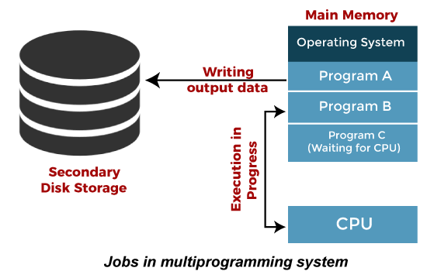
B. Not Interactive
Batch Processing is not suitable for jobs that are dependent on the user's input. If a job requires the input of two numbers from the console, then it will never get it in the batch processing scenario since the user is not present at the time of execution.
Multiprogramming Operating System
Multiprogramming is an extension to batch processing where the CPU is always kept busy. Each process needs two types of system time: CPU time and IO time.
In a multiprogramming environment, when a process does its I/O, The CPU can start the execution of other processes. Therefore, multiprogramming improves the efficiency of the system.
Advantages of Multiprogramming OS
Throughout the system, it increased as the CPU always had one program to execute.
Response time can also be reduced.
Disadvantages of Multiprogramming OS
Multiprogramming systems provide an environment in which various systems resources are used efficiently, but they do not provide any user interaction with the computer system

Slide 6
Time-sharing operating systems
Time-sharing is a technique which enables many people, located at various terminals, to use a particular computer system at the same time. Time-sharing or multitasking is a logical extension of multiprogramming. Processor's time which is shared among multiple users simultaneously is termed as time-sharing.
The operating system uses CPU scheduling and multiprogramming to provide each user with a small portion of a time. Computer systems that were designed primarily as batch systems have been modified to time-sharing systems.
Advantages of Timesharing operating systems are as follows −
Provides the advantage of quick response.
Avoids duplication of software.
Reduces CPU idle time.
Disadvantages of Time-sharing operating systems are as follows −
Problem of reliability.
Question of security and integrity of user programs and data.
Problem of data communication

Slide 7
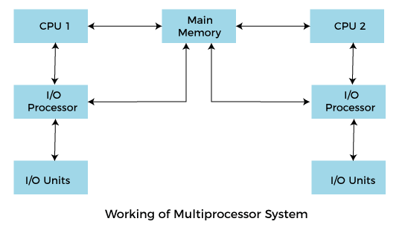
Multiprocessing Operating System
In Multiprocessing, Parallel computing is achieved. There are more than one processors present in the system which can execute more than one process at the same time. This will increase the throughput of the system.
4. Multiprocessing Operating System
In Multiprocessing, Parallel computing is achieved. There are more than one processors present in the system which can execute more than one process at the same time. This will increase the throughput of the system
In Multiprocessing, Parallel computing is achieved. More than one processor present in the system can execute more than one process simultaneously, which will increase the throughput of the system

Slide 8
Types of Multiprocessing OS
Asymmetric Multiprocessing
Asymmetric multiprocessing is the use of two or more processors handled by one master processor. All CPUs are interconnected but are not self-scheduling. AMP is used to schedule specific task to CPU based on priority and importance of task.
Symmetric Multiprocessing
Symmetric multiprocessing is the use of two or more self-scheduling processors sharing a common memory space. Each processor has access to I/O and memory devices. SMP applies multiple CPUs to a task to complete in parallel and faster fashion.

Slide 9
Sr. No. | Key | Asymmetric Multiprocessing | Symmetric Multiprocessing
1 | CPU | All processors are not equal in precedence. | All processors are same in precedence.
2 | OS Task | OS task is done by master processor. | OS task can be done by any processor.
3 | Communication Overhead | No communication overhead between processors as they are controlled by master processor. | All processor communicates to each other using shared memory.
4 | Process Scheduling | Master-Slave approach is used. | A ready queue of processes is used.
5 | Cost | Asymmetric multiprocessing is cheaper to implement. | Symmetric multiprocessing is costlier to implement.
6 | Design Complexity | Asymmetric multiprocessing is simpler to design. | Symmetric multiprocessing is complex to design.

Slide 10
Advantages of Multiprocessing operating system:
Increased reliability: Due to the multiprocessing system, processing tasks can be distributed among several processors. This increases reliability as if one processor fails, the task can be given to another processor for completion.
Increased throughout: As several processors increase, more work can be done in less.
Disadvantages of Multiprocessing operating System
Multiprocessing operating system is more complex and sophisticated as it takes care of multiple CPUs simultaneously.

Slide 11
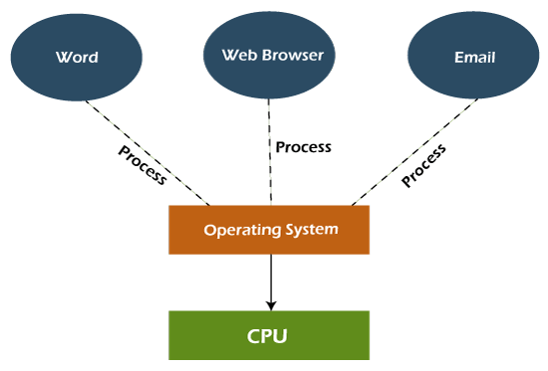
5. Multitasking Operating System
The multitasking operating system is a logical extension of a multiprogramming system that enables multiple programs simultaneously. It allows a user to perform more than one computer task at the same time.
Types of multitasking OS
Preemptive multitasking
Cooperative multitasking
Advantages of Multitasking operating system
This operating system is more suited to supporting multiple users simultaneously.
The multitasking operating systems have well-defined memory management.
Disadvantages of Multitasking operating system
The multiple processors are busier at the same time to complete any task in a multitasking environment, so the CPU generates more heat.

Slide 12
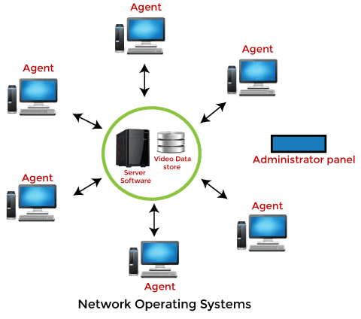
6. Network Operating System
An Operating system, which includes software and associated protocols to communicate with other computers via a network conveniently and cost-effectively, is called Network Operating System. A Network Operating System runs on a server and provides the server the capability to manage data, users, groups, security, applications, and other networking functions. The primary purpose of the network operating system is to allow shared file and printer access among multiple computers in a network, typically a local area network (LAN), a private network or to other networks.
Examples of network operating systems include Microsoft Windows Server 2003, Microsoft Windows Server 2008, UNIX, Linux, Mac OS X, Novell NetWare, and BSD.

Slide 13
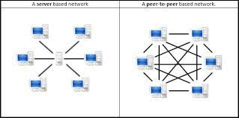
Types of Network Operating System
Peer-to-Peer:
In peer-to-peer (P2P): networking, a group of computers are linked together with equal permissions and responsibilities for processing data. Unlike traditional client-server networking, no devices in a P2P network are designated solely to serve or to receive data. Each connected machine has the same rights as its “peers”, and can be used for the same purposes.
Client-Server Operating System:
The term "client/server" describes a type of distributed processing in which an application is divided into two parts, each possibly residing on separate operating systems, but working together to provide a service to the end user

Slide 14
Advantages of Network Operating System
In this type of operating system, network traffic reduces due to the division between clients and the server.
This type of system is less expensive to set up and maintain.
Centralized servers are highly stable.
Security is server managed.
Upgrades to new technologies and hardware can be easily integrated into the system.
Remote access to servers is possible from different locations and types of systems.
Disadvantages of Network Operating System
In this type of operating system, the failure of any node in a system affects the whole system.
Security and performance are important issues. So trained network administrators are required for network administration.
High cost of buying and running a server.
Dependency on a central location for most operations.
Regular maintenance and updates are required

Slide 15
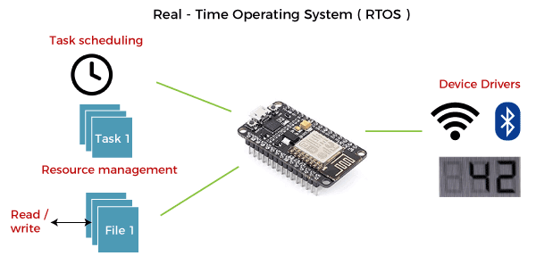
7. Real Time Operating System
A real-time system is defined as a data processing system in which the time interval required to process and respond to inputs is so small that it controls the environment. The time taken by the system to respond to an input and display of required updated information is termed as the response time. So in this method, the response time is very less as compared to online processing.
Real-time systems are used when there are rigid time requirements on the operation of a processor or the flow of data and real-time systems can be used as a control device in a dedicated application. A real-time operating system must have well-defined, fixed time constraints, otherwise the system will fail. For example, Scientific experiments, medical imaging systems, industrial control systems, weapon systems, robots, air traffic control systems, etc.

Slide 16
2 TYPES OF REAL TIME OPERATING SYSTEM
a. Hard real-time systems
Hard real-time systems guarantee that critical tasks complete on time. In hard real-time systems, secondary storage is limited or missing and the data is stored in ROM. In these systems, virtual memory is almost never found.
In Real-Time Systems, each job carries a certain deadline within which the job is supposed to be completed, otherwise, the huge loss will be there, or even if the result is produced, it will be completely useless.
b. Soft real-time systems
Soft real-time systems are less restrictive. A critical real-time task gets priority over other tasks and retains the priority until it completes. Soft real-time systems have limited utility than hard real-time systems. For example, multimedia, virtual reality, Advanced Scientific Projects like undersea exploration and planetary rovers, etc.

Slide 17
Example:-
The Application of a Real-Time system exists in the case of military applications, if you want to drop a missile, then the missile is supposed to be dropped with a certain precision.
Advantages of Real-time operating system:
Easy to layout, develop and execute real-time applications under the real-time operating system.
In a Real-time operating system, the maximum utilization of devices and systems.
Disadvantages of Real-time operating system:
Real-time operating systems are very costly to develop.
Real-time operating systems are very complex and can consume critical CPU cycles.

Slide 18
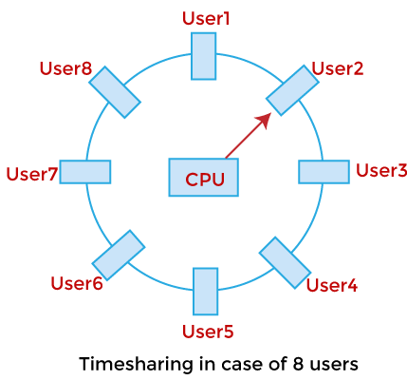
8. Time-Sharing Operating System:
Time-sharing is a technique where multiple users at different terminals can use a computer system simultaneously. It is an extension of multiprogramming and enables multitasking. The CPU time is divided among several users in small time slices or quanta, allowing for rapid switching between tasks.
Key Points:
Objective: To minimize response time and provide interactive computing.
CPU Scheduling: OS schedules each user for a small time slice.
Quick Response: Users receive output in seconds, making it feel like exclusive use of the system.
Difference from Batch Systems: Batch systems aim to maximize CPU usage, while time-sharing aims to reduce user wait time.
Example: Used in transaction processing, where user commands are executed with minimal delay.
Modern Use: Older batch systems were adapted into time-sharing systems.
Time-sharing OS allows concurrent user interaction by allocating CPU time efficiently, making computing resources accessible to many users at once.

Slide 19
* Advantages of Time Sharing Operating System
The time-sharing operating system provides effective utilization and sharing of resources.
This system reduces CPU idle and response time.
Provides the advantage of quick response.
Avoids duplication of software.
Disadvantages of Time Sharing Operating System
Data transmission rates are very high in comparison to other methods.
Security and integrity of user programs loaded in memory and data need to be maintained as many users access the system at the same time.
Problem of reliability.
Question of security and integrity of user programs and data.
Problem of data communication
A time-sharing operating system allows many users to be served simultaneously, so sophisticated CPU scheduling schemes and Input/output management are required, So Time-sharing operating systems are very difficult and expensive to build

Slide 20
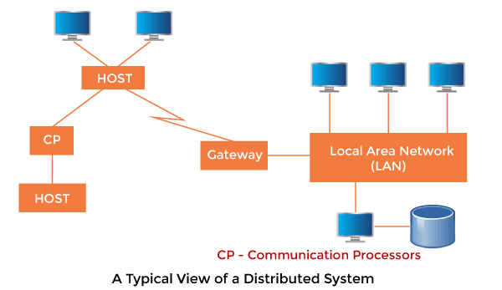
Distributed Operating System
Distributed systems use multiple central processors to serve multiple real-time applications and multiple users. Data processing jobs are distributed among the processors accordingly.
The processors communicate with one another through various communication lines (such as high-speed buses or telephone lines). These are referred to as loosely coupled systems or distributed systems. Processors in a distributed system may vary in size and function. These processors are referred to as sites, nodes, computers, and so on.
The Distributed Operating System is not installed on a single machine. It is divided into parts, and these parts are loaded on different machines. A part of the distributed operating system is installed on each machine to make their communication possible.
Distributed Operating Systems are much more complex, large, and sophisticated than Network Operating Systems, because they also have to take care of varying networking protocols.

Slide 21
Advantages of Distributed Operating System
The distributed operating system provides sharing of resources.
This type of system is fault-tolerant.
With resource sharing facility, a user at one site may be able to use the resources available at another.
Speedup the exchange of data with one another via electronic mail.
If one site fails in a distributed system, the remaining sites can potentially continue operating.
Better service to the customers.
Reduction of the load on the host computer.
Reduction of delays in data processing.
Disadvantages of Distributed Operating System
Protocol overhead can dominate computation cost.

Slide 22
Modern Operating System
Modern Operating Systems provide advanced features like virtual memory, which allows programs to use more memory than what is physically available in the system. This is done by moving parts of data between main memory (RAM) and disk storage as needed. The process is transparent to the user.
The virtual memory is divided into blocks called pages, and the physical memory is divided into page frames of the same size.
A page table is used to map virtual addresses to physical addresses (page frames) and to keep track of which pages are loaded or not.
If a program tries to access a page that is not currently in memory, a page fault occurs.
In case of a page fault, the OS:
Interrupts the CPU.
Selects a rarely used page to remove.
Saves that page back to the disk.
Loads the required page from disk to the now free page frame.
Updates the page table and restarts the instruction that was interrupted.
Typically, the page size in modern systems is 4,096 bytes (4 KB).
In addition to memory management, modern OSs also have built-in networking support. This includes:
Protocol processing to support application and transport layers (like TCP/IP).
Functions for packet forwarding, making it possible for the system to act as a router if needed.

Slide 23
unit:2 operating system organisation

Slide 24
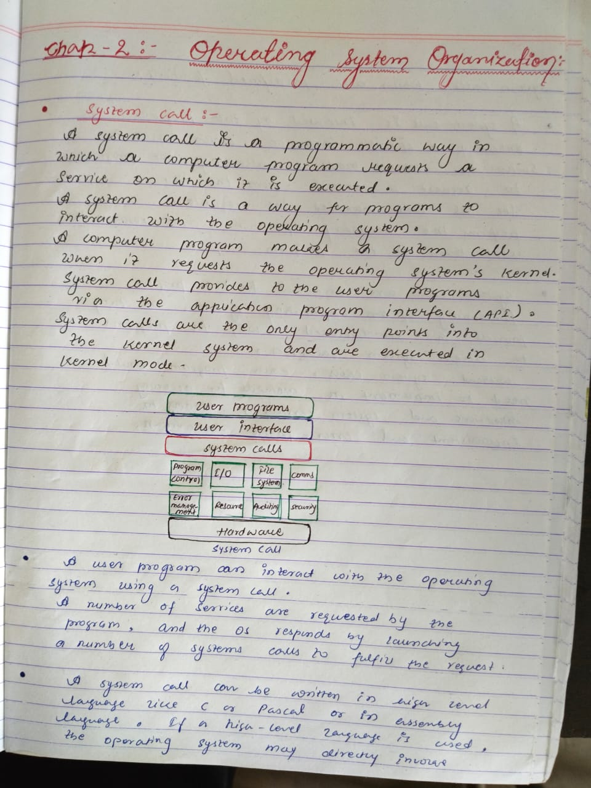

Slide 25
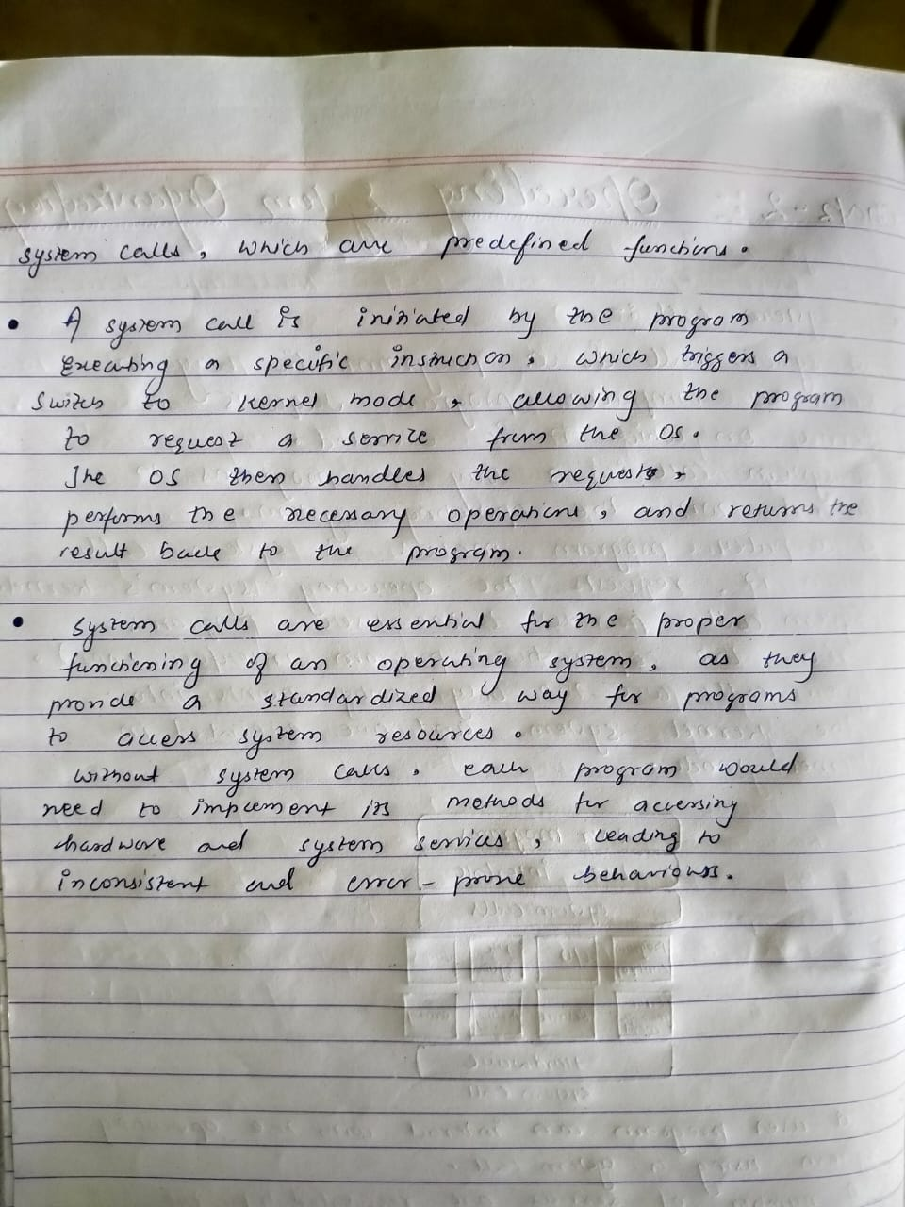

Slide 26
Q.write difference between user mode and kernal mode
Feature | User Mode | Kernel Mode
Definition | Mode in which user applications run | Mode in which operating system code runs
Access to Hardware | No direct access to hardware | Full access to hardware and system resources
Privilege Level | Low privilege | High privilege
Instruction Access | Cannot execute privileged instructions | Can execute any CPU instruction
System Call Usage | Requires system calls to access OS services | Can access all system resources directly
Stability | Errors affect only the application | Errors can crash the entire system
Security | More secure, restricted operations | Less secure, full control
Examples | Applications like MS Word, browsers, games | Memory management, device drivers, file system operations
.

Slide 27
User Mode

